Slide 1
Mile Korubin
Modern Macedonian artist

Slide 2
Mile Korubin
Mile Korubin was born in 1922, in Prilep.
In 1951, he graduated at the Academy of Art in Belgrade. He worked in the Macedonian Museum of History.
He specialized in Paris, 1963/1964.
His artists work went through a few different discourses. He was influenced by some French painters in his early stage of creation. The most common motives are fragmented urban landscapes from the countries he was to.

Slide 3
Life of Mile Korubin
Mile Korubin graduated from the Academy of Arts in Belgrade, in the class of professor Milo Miunovikh.
He was a teacher in the gymnasium “Josip Broz Tito”, Skopje, worked in the Historical Museum of Macedonia, and he was the headmaster in the School of Applied Arts in Skopje.
Besides dealing with painting, he created even monumental works – mosaics, graffiti and stained glass – in many banks, homes and hotels in the country. He completed nine solo and took part in many significant exhibitions abroad – France, Slovenia, Italy, Yugoslavia and Croatia.
He died in Skopje, 2000.

Slide 4
Creativity of Mile Korubin
Simple and unassuming, Korubin is devoted to the warm lyricism, melancholy, seduction of esoteric and exotic, to the sensuality of the show.
The idyllic figuration, association and geometric figuration dominate in his creation. They do not refer to visible clear form, but they expand the horizons of the hedonism. Thus, the gravitational matrix of fine art becomes a beauty – one of the most abstract and the most disputable art movement in the 20th century.

Slide 5
Creativity of Mile Korubin
Korubin’s opus is released from the delusions of the art rules. He used relaxed the experience of art history and adapted them to his own temperament and intuition. Thus, he became the herald of postmodernism in Macedonia.
His approach to the themes, content, prototypes and artistic orientations, is specific. That can be “read” in his paintings from different periods which may have a time span of a several decades.

Slide 6
Creativity of Mile Korubin
The inception of the actual testimony of Mile Korubin was manifested at the time of one of the most exciting decades of Macedonian culture and history in the last century (1950-1960). Those were the years when a step out of the norms of dictated creativity in Macedonia was taken.
On the territory of Israel, Korubin’s curiosity for the exotic beauty of women with dark complexion was born. The painting of Mile Korubin of the sixties in the last century showed some signals of anticipation of non-representative (simplification of forms and leveling of the plans). Korubin broke the senseless antagonism between the abstraction and figuration.

Slide 7
Creativity of Mile Korubin
There are three major events in Mile Korubin’s life: the three-month stay in Israel (1960), the Skopje cataclysm (1963) and the stay in Paris as a student (1963), including his solo exhibition in Dijon (1964).
Mile Korubin’s paintings in oil are: “Beam”, “Rondo”, “Abstraction”, “Insomnia”, “Harmony in White”, “Trails”, etc.

Slide 8
Works by Mile Korubin

Slide 9
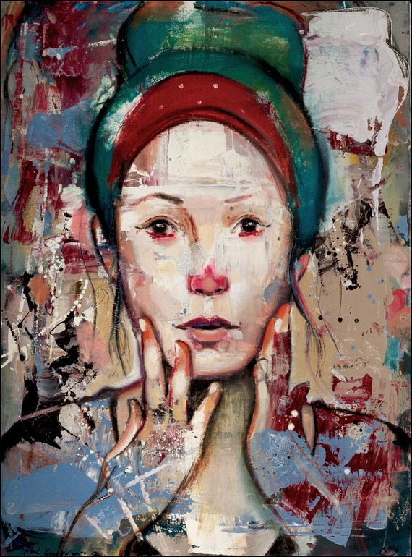

Slide 10
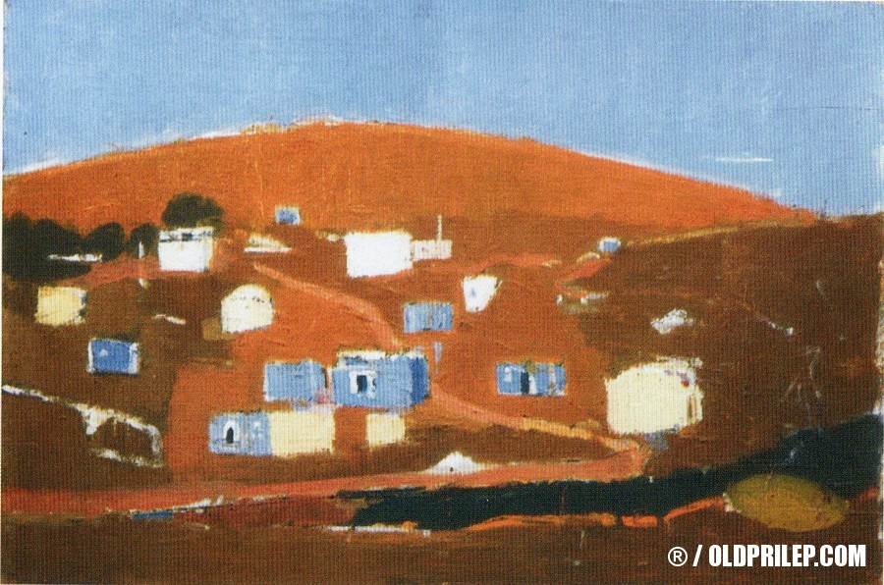

Slide 11
